Slide 1
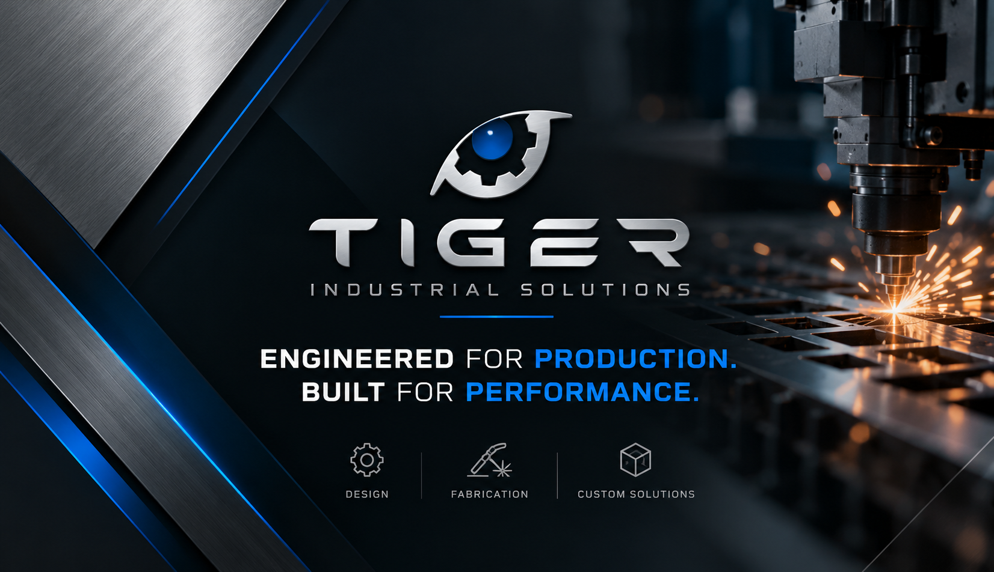

Slide 2
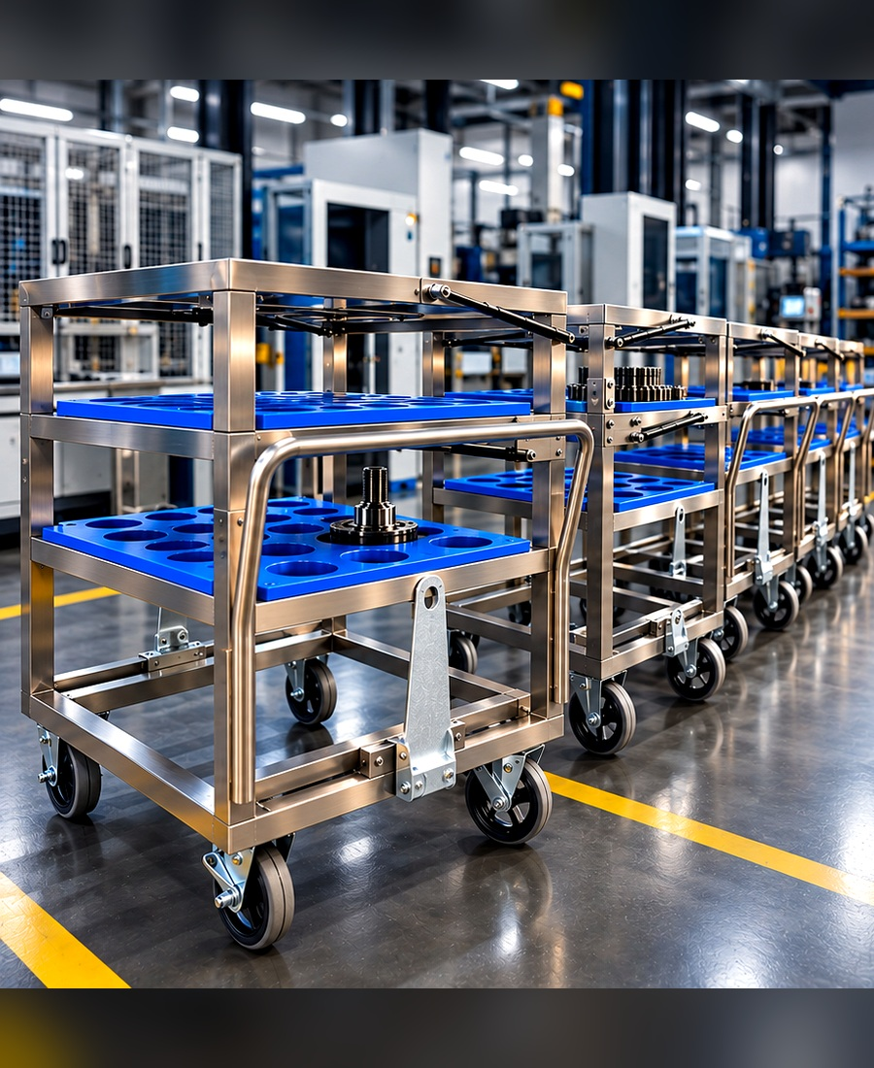
BUILT AROUND YOUR PRODUCTION PROCESS
WHO WE ARE
In Tiger Industrial Solutions we design and manufacture custom equipment for production lines, material handling, and industrial operations.
Metal fabrication • CNC machining
Welding • Engineering plastics
TIGER / INDUSTRIAL SOLUTIONS
02

Slide 3
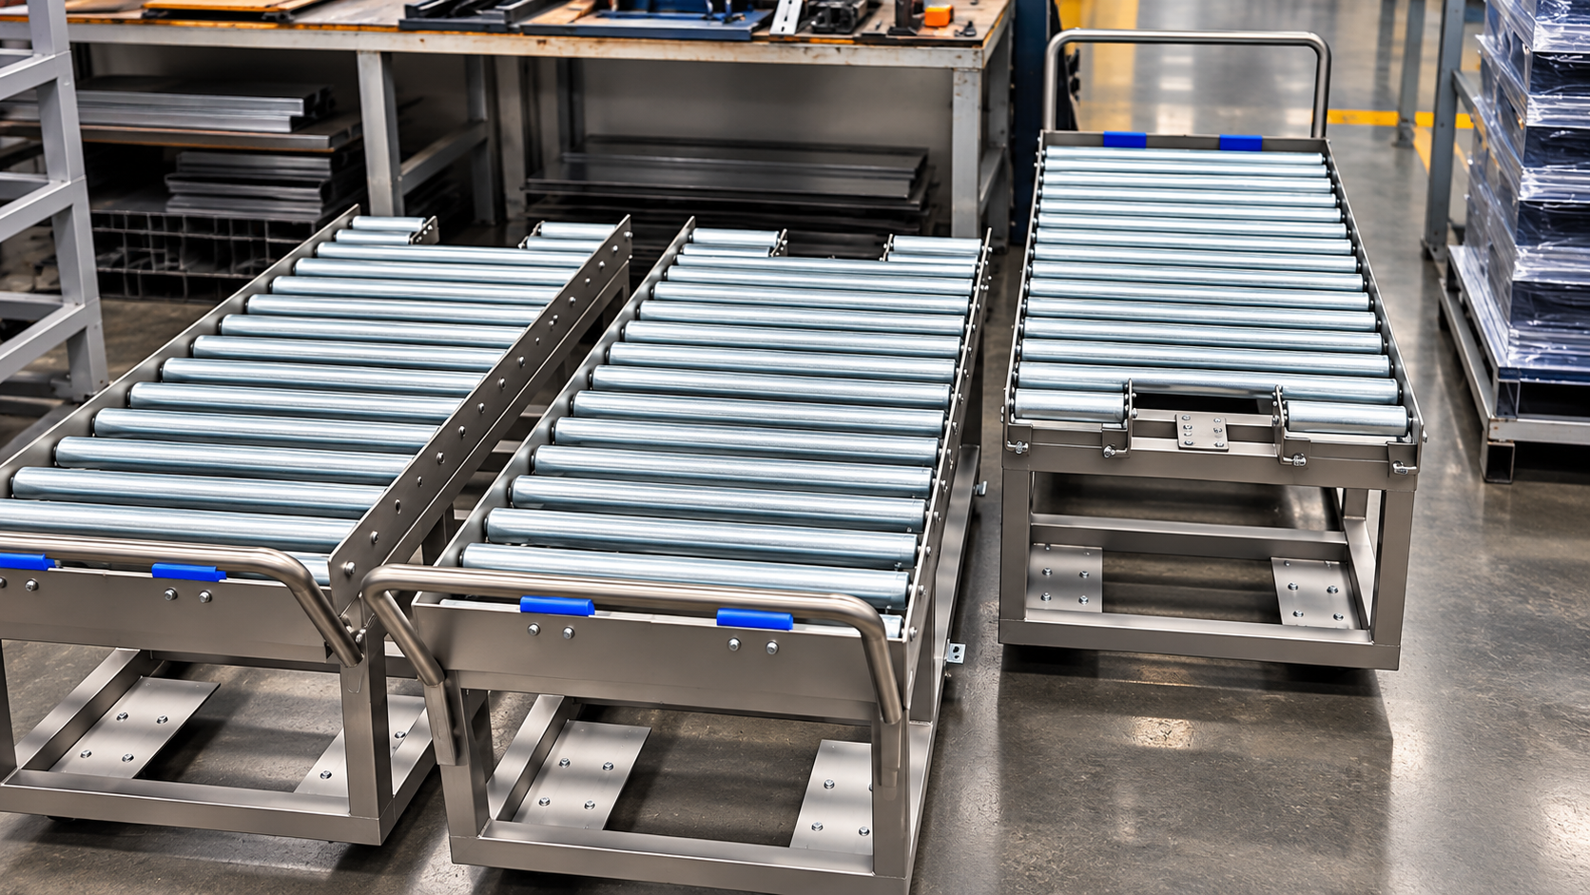
ENGINEERING THAT SOLVES REAL PROBLEMS
Purpose-built for each production process
Protect valuable components during handling
Improve operator access and ergonomics
Organize work-in-process material flow
Designed for demanding industrial use
TIGER / INDUSTRIAL SOLUTIONS
03

Slide 4
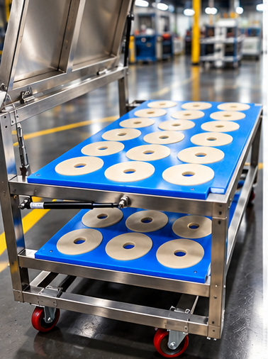
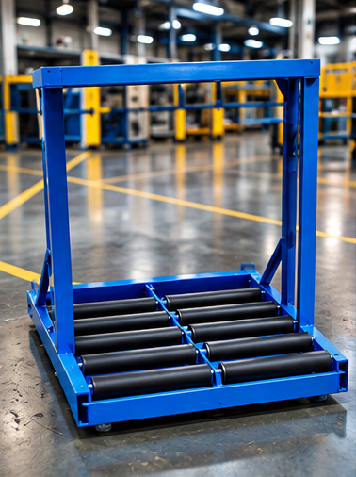
CUSTOM MATERIAL HANDLING EQUIPMENT
DESIGNED FOR THE FACTORY FLOOR
Mobile production carts
Stainless-steel frames with precision-cut inserts
Custom layouts for component positioning
TIGER / INDUSTRIAL SOLUTIONS
04

Slide 5
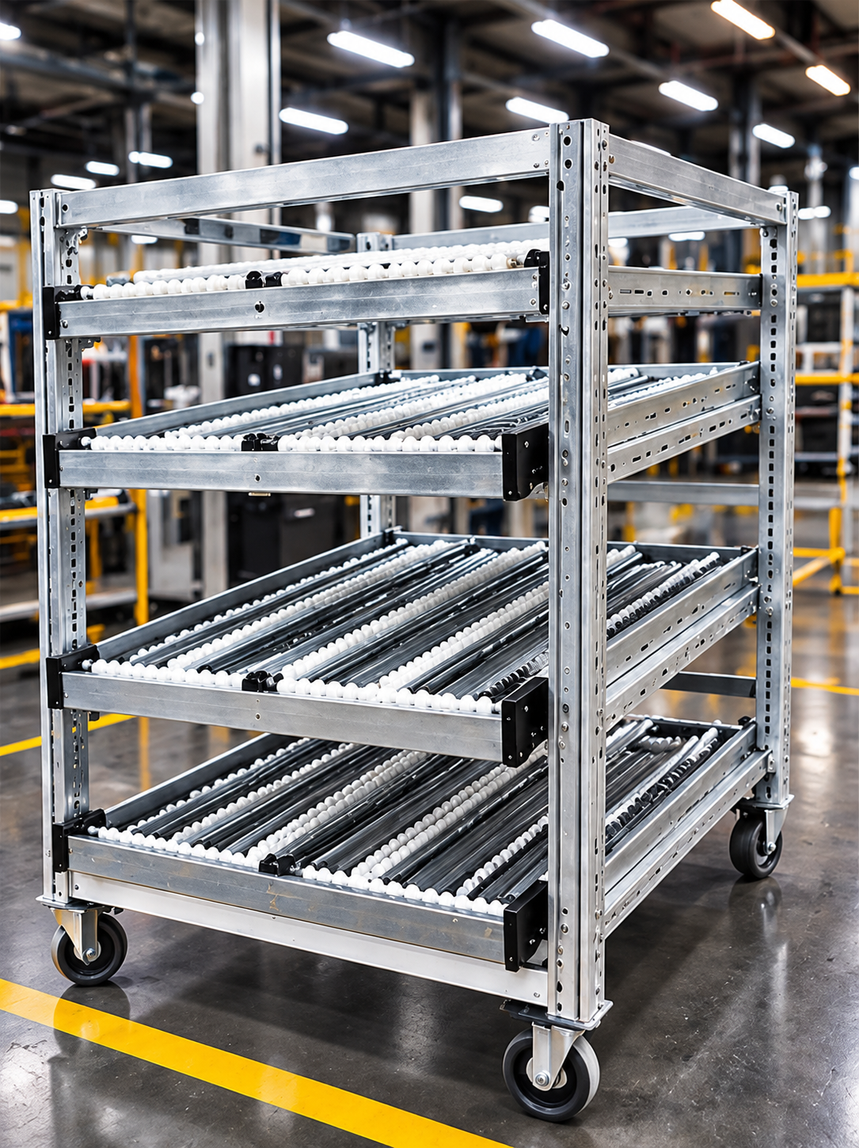
MOBILE FLOW RACKS & FIFO SYSTEMS
DESIGNED FOR THE FACTORY FLOOR
Multi-level flow racks
Roller tracks and gravity-fed movement
Adaptable to line-side material presentation
TIGER / INDUSTRIAL SOLUTIONS
05

Slide 6
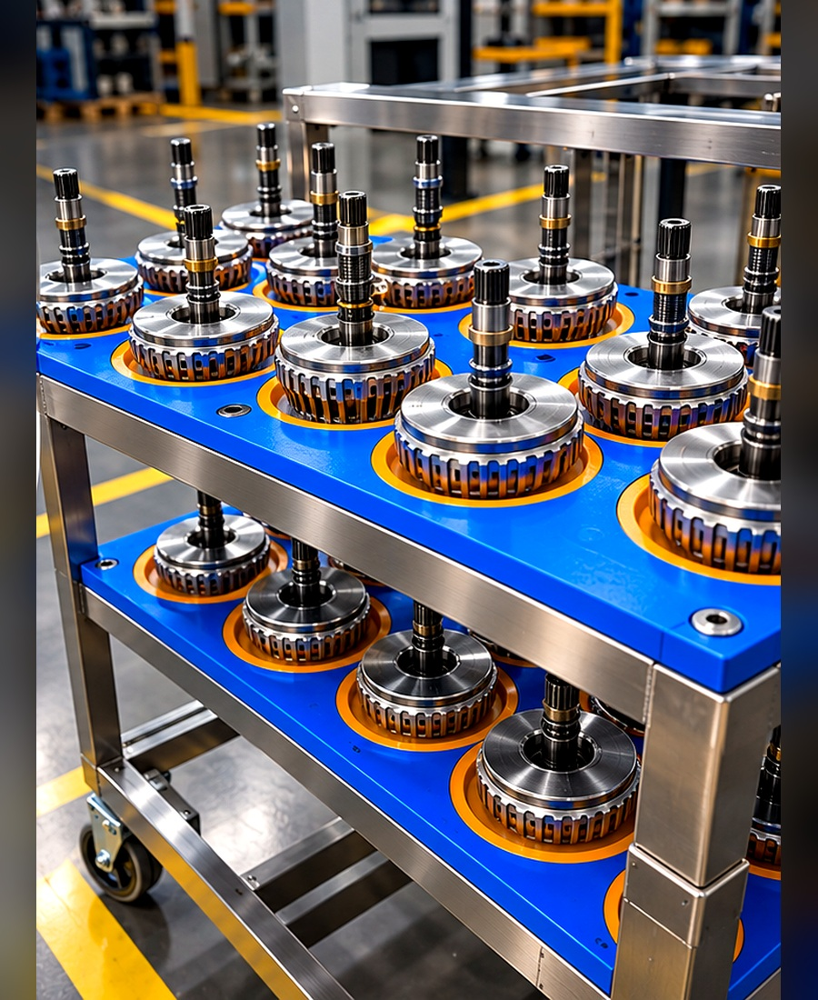
STAINLESS STEEL PRODUCTION SOLUTIONS
DESIGNED FOR THE FACTORY FLOOR
Custom stainless-steel carts and fixtures
Blue nylon and white protective inserts
Purpose-built part support and handling
TIGER / INDUSTRIAL SOLUTIONS
06

Slide 7
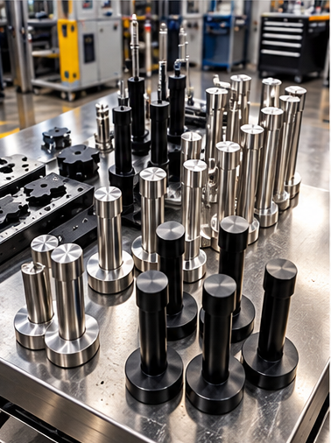
CNC MACHINING & ENGINEERING PLASTICS
DESIGNED FOR THE FACTORY FLOOR
Custom-machined HDPE and nylon components
Precision supports, guides and inserts
Metal parts and production tooling
TIGER / INDUSTRIAL SOLUTIONS
07

Slide 8
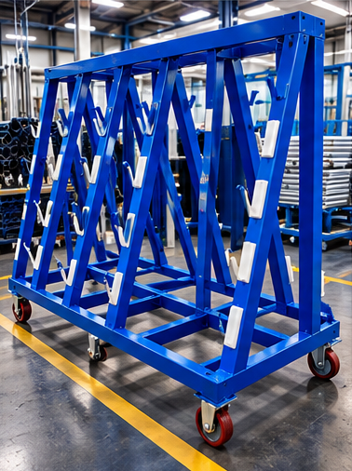
CUSTOM FABRICATED STRUCTURES
DESIGNED FOR THE FACTORY FLOOR
Welded steel storage and handling frames
Mobile industrial fixtures
Built around part geometry and workflow
TIGER / INDUSTRIAL SOLUTIONS
08

Slide 9
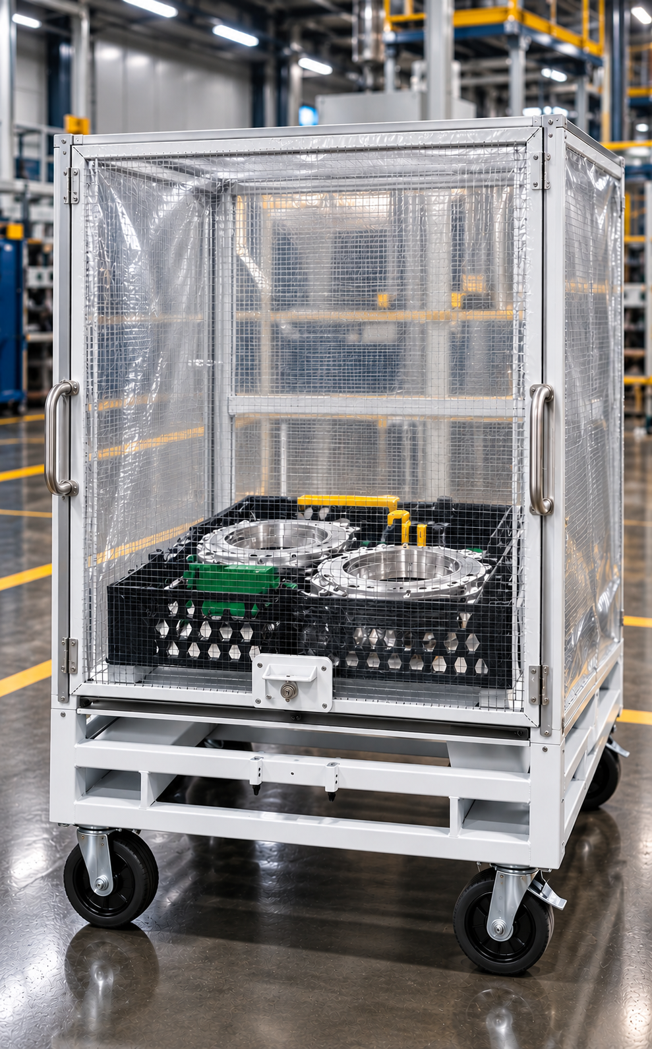
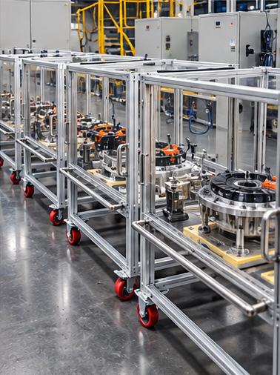
COMPONENT PROTECTION & SPECIALIZED HANDLING
DESIGNED FOR THE FACTORY FLOOR
Protective enclosures and mobile carriers
Part separation and dedicated supports
Handling solutions for sensitive assemblies
Creating clean and dry environment for
Special parts
TIGER / INDUSTRIAL SOLUTIONS
09

Slide 10
OUR MANUFACTURING CAPABILITIES
METAL FABRICATION
CNC MACHINING
WELDING
Stainless and carbon steel structures
Machined metal and engineering plastics
Industrial welded assemblies
MATERIAL HANDLING
ENGINEERING PLASTICS
3D PRINTING AND SCANNING
Carts, racks, flow systems and fixtures
HDPE, nylon and polyurethane components
Metal and Plastic parts
TIGER / INDUSTRIAL SOLUTIONS
10

Slide 11
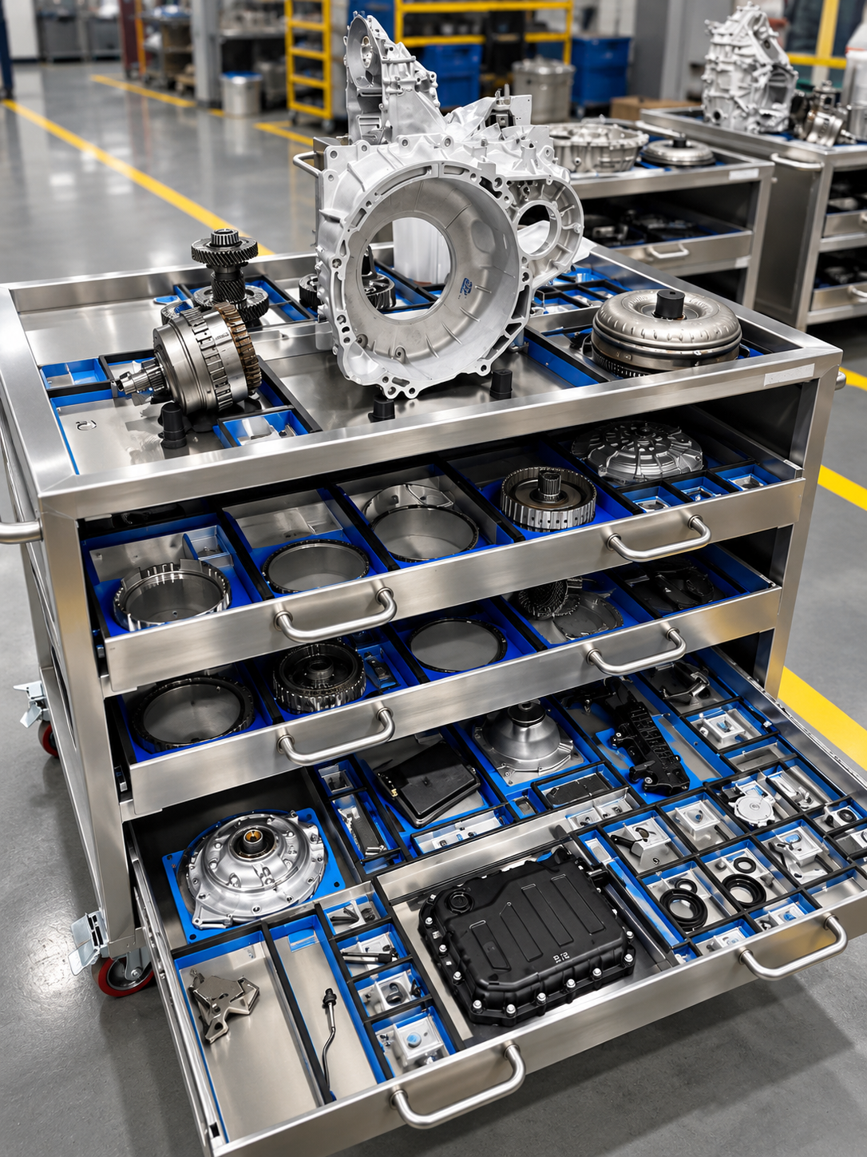
LET’S BUILD SOMETHING
THAT WORKS.
TIGER INDUSTRIAL SOLUTIONS
Monterrey, Nuevo León, Mexico
Emanuel Leyva • Gustavo Leyva
+52 346 482 9703
ventas@tigre-engineering.com

Slide 12
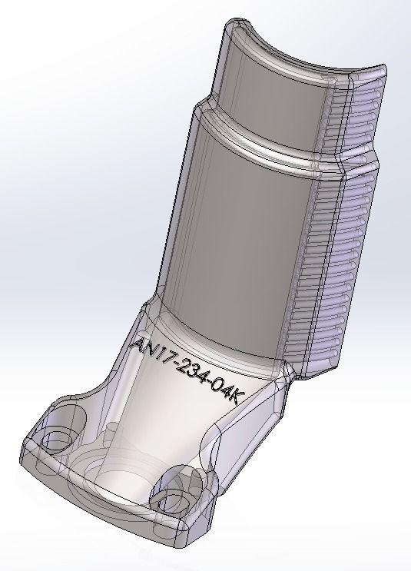
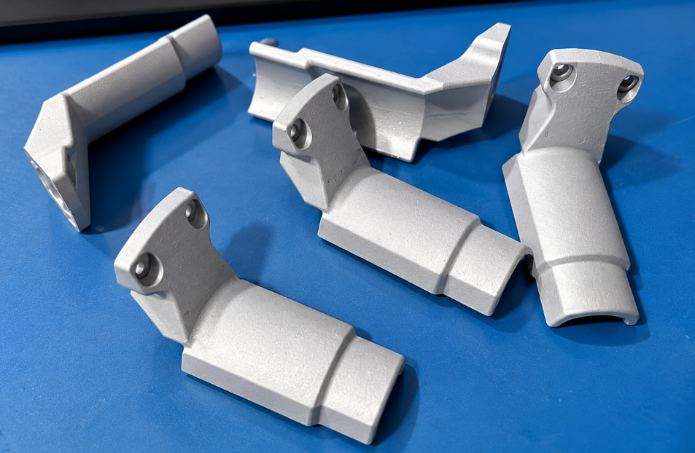
3D PRINTING & SCANNING
METAL & PLASTIC COMPONENTS
3D-PRINTED METAL & PLASTIC PARTS
3D SCANNING & REVERSE ENGINEERING
TIGER INDUSTRIAL SOLUTIONS / CUSTOM INDUSTRIAL SOLUTIONS

